Slide 1

DATA STRUCTURE AND ANALYSIS
PREFORMED BY-
ASHUTOSH TIWARI
SHREYAS CHIKHALIKAR

Slide 2

PROBLEM DEFINATION
To implement a c program for quiz competition using stack as a underlining data structure
The toughest question is added first.
The easiest question is added last.
So, final question can be reached after first 9 questions.

Slide 3
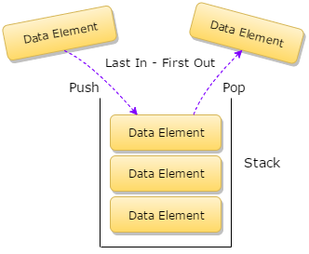
Stack
Stack is a linear data structure which follows a particular order in which the operations are performed. The order may be LIFO (Last In First Out) or FILO (First In Last Out).

Slide 4
STACK OPERATION
The common operation that can be performed on stacks are-
Push()
Pop()
Peep()

Slide 5
STACK OPERATION
Push()
Adds an item in the stack. If the stack is full, then it is said to be an Overflow condition.
Pop()
Removes an item from the stack. The items are popped in the reversed order in which they are pushed. If the stack is empty, then it is said to be an Underflow condition.
Peek()
Returns top element of stack.

Slide 6
About the project
The program which we have implemented is a quiz which uses stack as its underlining data structure.
The quiz includes 10 questions which are pushed into the stack with decreasing order of their difficulty.
You will be given 4 options.
If you give the right answer you score (10-i)*10 points , i stands for position where the question is present in the stack.
i.e Points will increase linearly with 10,20,30.. Uptil 100.
According to the above formula maximum marks that can be obtained is 550.
If you answer all the questions correctly you will win the quiz .

Slide 7
About the project
If you give any wrong answers you will be disqualified and 50 points would be deducted from your point tally.
If you wish to quit the quiz midway you can select the option ‘0’,by doing this you will be removed from the quiz and will get points for correct answers.

Slide 8
Algorithm
Step 1: INITALIZATION points=0
top=-1
max=10
i=9
step 2: STORING QUESTION AND ANSWER
construct 2D array name stackQ of sixe10*256
Initalize the stack with questions of decreasing difficulty such that easiest question is pushed last to pop first.
Push answer into the array name stackAns.
Step 3:
print "Welcome"
scan name.

Slide 9
Step 4:
print stackQ[i]
scan ans
if (ans=stackAns[i])
points=points+(10-i)*10
print "correct"
else if(ans=0)
print "You quit"
else
print "Correct answer is %d",stackAns
points = points -50
break
Step 5:
i--
if(i>=0)
goto STEP 4

Slide 10
Step 6:
print points
Step 7:END.

Slide 11
Code
#include<stdio.h>
#include<conio.h>
#include<string.h>
#include<stdlib.h>
#include<dos.h>
#define max 10
char *stackQ[max][256];
int stackAns[max];
int top=-1;
void pushAns(int a)
{
top=top+1;
stackAns[top]=a;
}

Slide 12
void main()
{
printf("A miniproject bought to you by\n Ashutosh Tiwari(48) and Shreyas Chikhlikar(50)\n");
printf("A quizeria using STACK as the data structure to pop the first and most valued question at last.\n");
int points=0,i,ans;
char name;
char stackQ[max][256]={"Final Question!!\n1)A\t2)B\t3)C\t4)D", "9th Question!!\n1)A\t2)B\t3)C\t4)D","8th Question!!\n1)A\t2)B\t3)C\t4)D","7th Question!!\n1)A\t2)B\t3)C\t4)D","6th Question!!\n1)A\t2)B\t3)C\t4)D","5th Question!!\n1)A\t2)B\t3)C\t4)D","4th Question!!\n1)A\t2)B\t3)C\t4)D","3rd Question!!\n1)A\t2)B\t3)C\t4)D","2nd Question!!\n1)A\t2)B\t3)C\t4)D","1st Question!!\n1)A\t2)B\t3)C\t4)D"};
pushAns(4); //push 10 ans.
pushAns(1);
pushAns(1);
pushAns(1);
pushAns(1);
pushAns(1);
pushAns(1);
pushAns(1);
pushAns(1);
pushAns(1);

Slide 13
printf("\nWelcome to Quizeria.\n");
printf("Enter your name. \n");
name=scanf("%s",&name);
printf("Welcome %s\n",name);
for(i=9;i>=0;i--)
{
printf("\n\nThis question is for %d points\n",(10-i)*10); delay(100);
printf("%s\n",stackQ[i]);
delay(100);
printf("Enter your ans.\n");
scanf("%d",&ans);
delay(100);
if(ans==stackAns[i])
{
points=points+(10-i)*10;
printf("Congrats!!!\t You earn %d points\n",(10-i)*10);
}
else if(ans==0)
{
printf("You chose to quit\n");
break;
}
else
{

Slide 14
points=points-50;
printf("Sorry, the correct answer is %d. \n",stackAns[i]);
break;
}
}
if(points==550)
{
printf("You are the winner of the quizeria with %d points!!!\n",points);
}
else
{
printf("You scored %d points!!!\n",points);
}
getch();
}

Slide 15
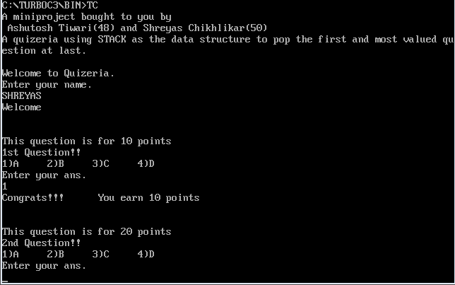
Output

Slide 16
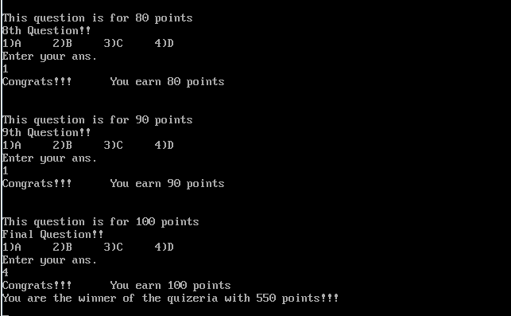
When the user answers all the question and wins the quiz

Slide 17
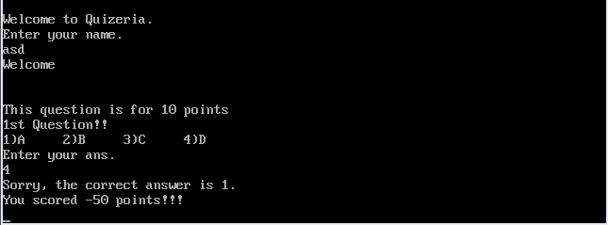
When the user answers the question incorrectly

Slide 18
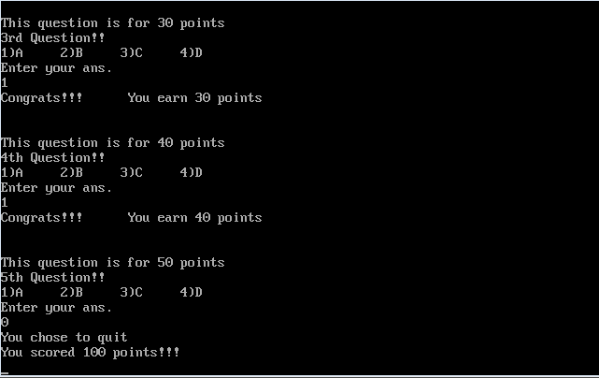
When user decides to quit midway

Slide 19

Conclusion
Thus we have successfully implemented the program for quiz using data structure stack in c language

Slide 20

Printf(“Thank You\n”);

